Slide 1
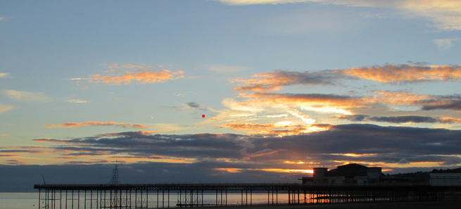
North & Mid Wales Association of Local councils
Quarterly Meeting 24th January 2025

Slide 2
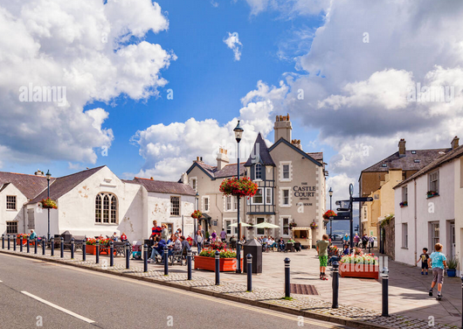
WELCOME TO BEAUMARIS
Welcome from the Mayor
of Beaumaris Town Council
Cllr David T Evans

Slide 3
North & Mid Wales Association of Local councils
Quarterly Meeting 24th January 2025

Slide 4
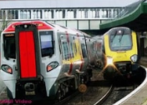
TFW LETTER FROM WELSH GOVERNMENT & AVANTI TRAIN SERVICE REPORT
Welshpool station and footbridge
Prestatyn station and security guards
Train formations, overcrowding, new trains and Shrewsbury to Chester
Station audits and disabled toilets
Degany crossing
Ministers meeting (transport – trains & A55)
Shrewsbury station
Avanti services

Slide 5
North & Mid Wales Association of Local councils
Quarterly Meeting 24th January 2025

Slide 6
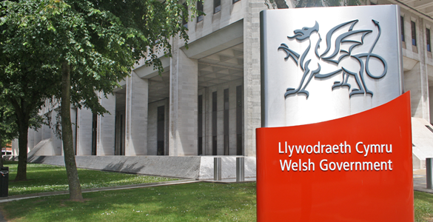
Visit to Welsh Government - Committee
Invite to Cardiff
Evidence from the Association
The review
What we do now

Slide 7
North & Mid Wales Association of Local Councils
Inquiry into the role, governance and accountability of the community and town council sector
There is a move to try and combine Councils and reduce the current councils from 735 to maybe as little as 150 (number given by Minister at meeting with Welsh Government).
The Welsh Government Senedd Committee is receptive to receiving further evidence from the Association including how Town and Community Councils go forward from here – to include amalgamating or clustering ideas.

Slide 8

North & Mid Wales Association of Local Councils
Inquiry into the role, governance and accountability of the community and town council sector
What is the reason behind
the need for less Town and
Community Councils?

Slide 9
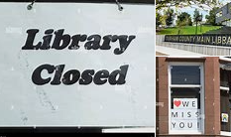
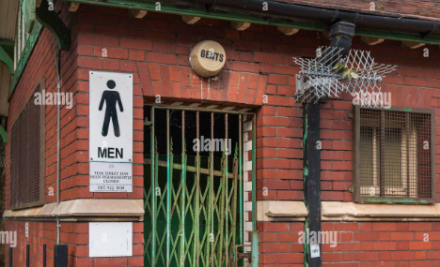
WHAT HAS CAUSED ALL THIS?
COUNTY COUNCIL REVIEW
FIVE REGIONS
LOCAL COUNCIL GOVERNANCE
COSTS
REPRESENTATION

Slide 10
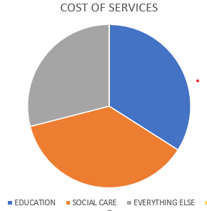
LETS LOOK AT THE COUNTY COUNCIL FIGURES

Slide 11
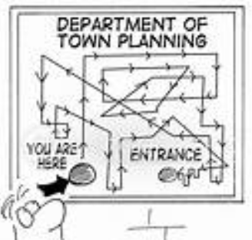
North & Mid Wales Association of Local Councils
Inquiry into the role, governance and accountability of the community and town council sector
Is the sector is fit for purpose in an
evolving local government landscape?

Slide 12
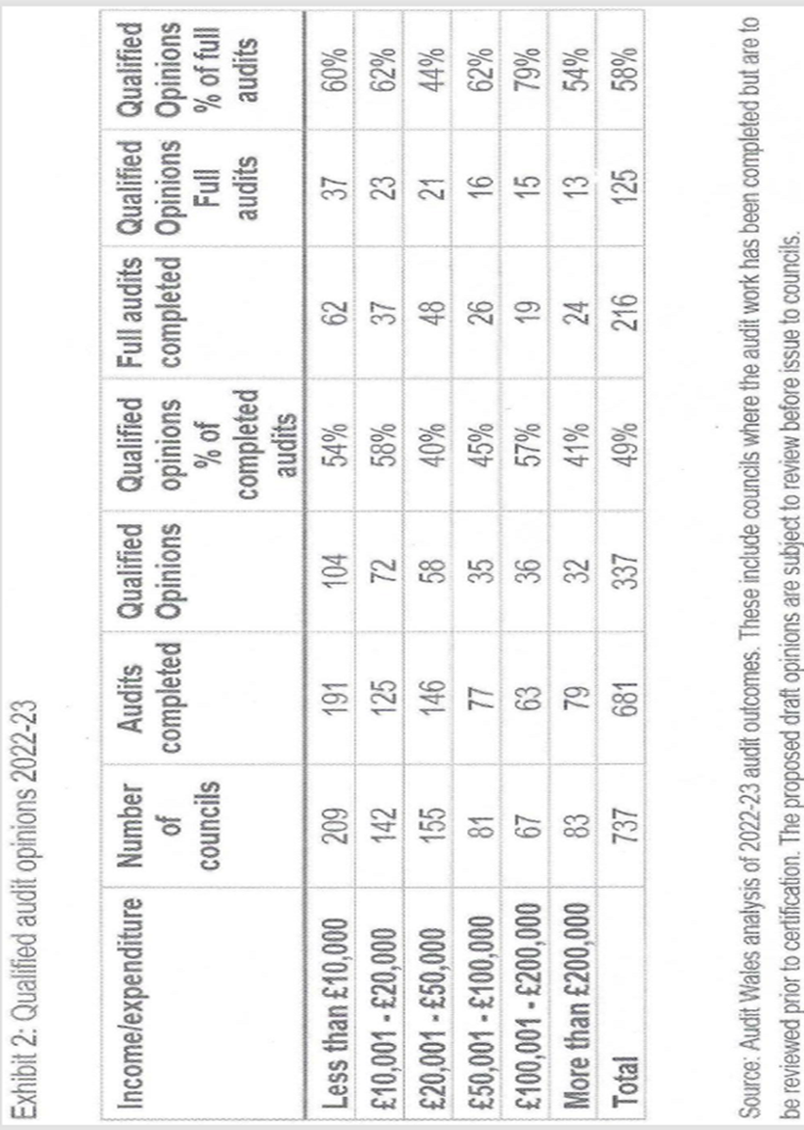
North & Mid Wales Association of Local Councils
Inquiry into the role, governance and accountability of the community and town council sector

Slide 13

North & Mid Wales Association of Local Councils
So how do we go from here?
Issues and ideas and views
Draft paper for discussion
Final paper before adoption

Slide 14

North & Mid Wales Association of Local Councils
Inquiry into the role, governance and accountability of the community and town council sector
Issues
Retaining identity
Loss of local representation
Size (to small to do much)
Larger councils dominating smaller councils
Land area and distances
VAT implications

Slide 15
North & Mid Wales Association of Local Councils
Inquiry into the role, governance and accountability of the community and town council sector
Issues
Culture and language
Staff and redundancy
Cost of admin and councillors
Finances – who has more money?
Whatever happens it will cost more

Slide 16
North & Mid Wales Association of Local Councils
Inquiry into the role, governance and accountability of the community and town council sector
Maybe four things to consider:
The need to change
The idea of combining councils
The idea of clustering councils
The idea of a mixture of both

Slide 17
North & Mid Wales Association of Local Councils
Inquiry into the role, governance and accountability of the community and town council sector
Suggestion:
Have three types of local council
a) Larger councils remain much as they are now
(budgets of over £200k)
b) Medium councils to combine in urban areas
(budgets of over £100k)
c) Smaller councils to cluster in more rural areas
(budgets under £100k)

Slide 18

North & Mid Wales Association of Local Councils
Funding of town and community councils
Town and Community Council funding:
  Often made up of
    80% precept
    10% other income
    10% grants
VAT – action already being followed up
Future funding:
* Precept
* Grants
* Direct funding

Slide 19
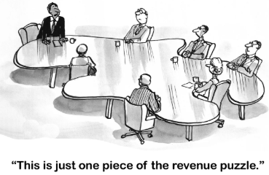
North & Mid Wales Association of Local Councils
Over to you

Slide 20

North & Mid Wales Association of Local Councils
QUARTERLY MEETING OF THE ASSOCIATION
24th January 2025

