Slide 1
2025/6 TfW North Wales
Timetable changes

Slide 2

Why are we changing the timetable?

Slide 3
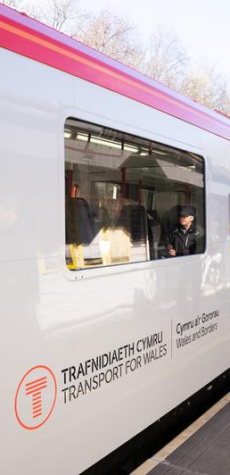
Why are we changing the North Wales timetable?
There isn’t enough capacity
  Trains are routinely crowded on peak summer holiday days
  TfW want to increase capacity by 50%
Trains aren’t frequent enough
  Chester <> Llandudno Junction is currently 2tph (TfW) plus Avanti trains in some hours – TfW want to increase this to 3 or 4tph (combined)
  Llandudno Junction <> Holyhead is currently 1tph (TfW) plus Avanti in some hours – TfW want to increase this to 2tph (combined)
  Llandudno Junction <> Llandudno (‘Town’) is 1tph in most hours – TfW want to increase this to 2tph

Slide 4
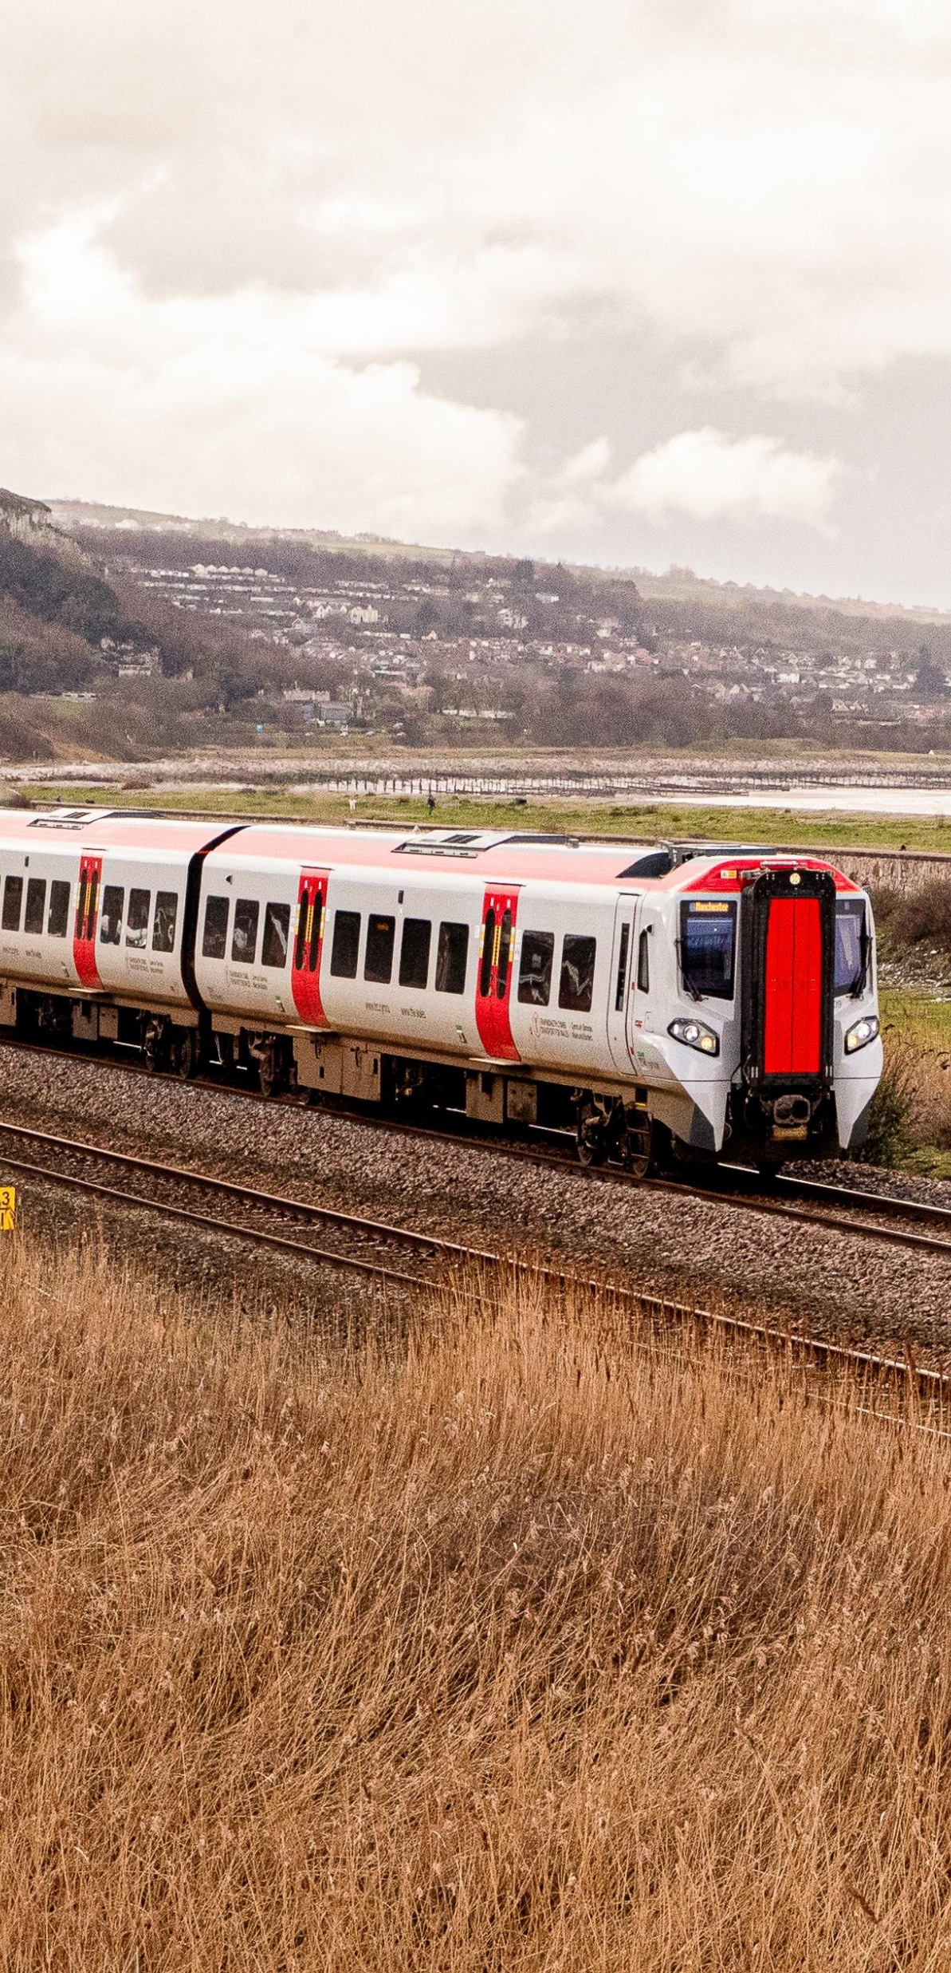
Why are we changing the North Wales timetable?
There are no direct services between North Wales and Liverpool
  Liverpool and North Wales have a natural connection but are not currently served by a direct service
The timetable could be more robust
  Today’s timetable has grown organically – but its not very reliable because late running trains can easily impact on each other
  We have a unique opportunity to build the timetable from the ground-up to achieve more optimal performance
  We want to provide more stations with a regular, clock-face service (same minutes past every hour)
  Make request stops compulsory where they’re sufficiently well used

Slide 5
When are the changes happening?

Slide 6
When will the timetable change?
14th December 2025
  Increase of 1 train per hour in most hours between Chester and Wrexham General every day
17th May 2026
  Major changes in North Wales (Chester <> Holyhead/Llandudno) on Monday – Saturdays
  Now ‘live’ on online Journey Planners (but may change again before May)

Slide 7
What are the major changes in North Wales from 17th May 2026?

Slide 8


Network North Wales
Standard hour in today’s Timetable (Dec’25) for North Wales
Liverpool Lime St
Calling pattern only shown Crewe <> Holyhead/Llandudno
Llandudno
Manchester Airport
London Euston
(Avanti)
Llandudno Jcn
Chester
Rhyl
Crewe
Holyhead
Bangor
Key
1 train per hour
1 train per 2 hours
Wrexham General
Less frequent
Cardiff Central
Blaenau Ffestiniog
Birmingham Int’l
Notes:
Not shown is the one train per day between Llandudno (Town) and Manchester Airport, departing from Llandudno at ~06:40 and returning from Manchester Airport at 17:25

Slide 9
Standard hour Timetable from May’26 for North Wales
Calling pattern and stations only shown Crewe <> Holyhead/Llandudno
Liverpool Lime St
Manchester Airport
Llandudno
Holyhead
Bangor
Llandudno Jcn
Rhyl
Chester
Crewe
Key
London Euston
(Avanti)
Wrexham
General
1 train per hour
1 train per 2 hours
Less frequent
Compulsory Stop
Cardiff Central
Request Stop
Blaenau Ffestiniog
Birmingham Int’l
Notes:
Not shown is the one train per day between Llandudno (Town) and Manchester Airport, departing from Llandudno at ~06:40 and returning from Manchester Airport at 17:25

Slide 10
Standard hour Timetable from May’26 for North Wales
Overall timetable
  Trains will run at the same minutes past each hour, most hours
  The timetable structure will be more robust, with sufficient recovery time to absorb minor delay and request stopping
  Platforming at Chester should be more consistent – same platform for the same departure every hour
Performance
  Sufficient dwell at busy stations and elimination of units with end-doors only (except MkIVs)
  Units won’t ‘interwork’ between different routes – this prevents delays on one route spreading to another route
  Conwy Valley unit remains ‘captive’ all day and doesn’t do other work
  Timings throughout North Wales have been rechecked and now bespoke for the cl.197 train, which will help Right-Time performance
  More robust turnarounds at the end of journeys – which means more trains will start their next journey on-time

Slide 11
Standard hour Timetable from May’26 for North Wales
Turnaround times
Location | Dec 25 | May 26 | +/-
Manchester Airport | 13 | 13 | -
Liverpool Lime St | 15 | 15 | -
Llandudno (Town) | Blaenau 5*/23 Manchester 45 | Blaenau 11 Liverpool 26*/56 | +6 on shortest + 11 overall
Blaenau | 4-12 | 8-14 | +4 on shortest
Holyhead/Llandudno Junction (Birmingham services) | 6 (at Holyhead) | 12 (at Llandudno Junction) | +6 and reduced journey
Holyhead | Cardiff 12-28 | Manchester 22 Cardiff 15 | +3 on shortest
Crewe | 5 | 5 | -
Wrexham (incl. shunt) | 14-24 | 40 | +26 on shortest

Slide 12
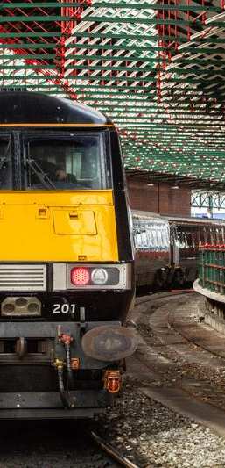
Standard hour Timetable from May’26 for North Wales
Rolling Stock
  By the end of 2026, all TfW services in North Wales will be operated by cl.197 (CAF Civity)...
    except the one MkIV train per weekday to and from Cardiff
    and cl.230s operating the Wrexham <> Bidston (for Liverpool) service
  Usual unit deployment will be;
    Manchester <> Holyhead, Cardiff <> Holyhead and Wrexham <> Bidston services = 3-car
    2x trains in each peak = 5-car between Chester and Manchester
    All other services = 2-car
    Some Liverpool services to be 3-car in Summer

Slide 13
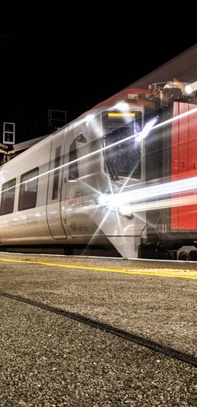
Standard hour Timetable from May’26 for North Wales
Between Crewe and Chester and Wrexham General
  The extra TfW train between Wrexham General and Chester is extended to Crewe in most hours, in the place of the Chester <> Crewe service
  Trains from Wrexham arrive at Crewe at xx:20 past the hour, connecting into Avanti’s xx:32 departure to London and TfW’s xx:30 departure to Manchester
  Trains to Wrexham depart from Crewe at xx:23 past the hour, connecting out of Avanti’s xx:08 arrival from London and TfW’s xx:07 arrival from Manchester

Slide 14
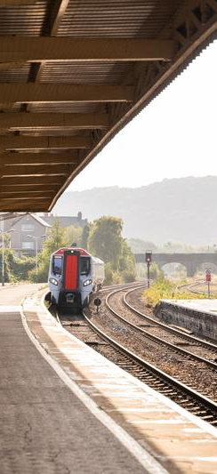
Standard hour Timetable from May’26 for North Wales
Between Chester and Llandudno Junction
  One extra TfW train every hour (i.e. 3tph) 07:00 – 20:00 Monday - Saturday between Chester and Llandudno Junction
    1tph is an extension of today’s Liverpool <> Chester service to Llandudno
    Capacity increases from 4.5 to 7 carriages per hour (compared with pre-cl.197 intro)
  All TfW trains call at all stations except for Shotton (2tph, Liverpool and Manchester trains – i.e. a doubling of calls) and Abergele & Pensarn (1tph, Liverpool trains)
  22:25 Manchester Airport > Chester is extended to Holyhead (23:58 from Chester) and connects into overnight ferries to Dublin
  23:25 Manchester Airport > Holyhead now ends at Llandudno Junction (00:51 from Chester)

Slide 15
Level Crossings
Improvements to the timetable have had to wait for safety measures to be agreed and implemented at 4x level crossings (Sandy Lane, Beverley Drive, Ty Gwyn and Pen Uchaf) in Prestatyn and Pensarn
These crossings have been identified among the highest-risk on the Wales and Borders network. While the level crossings are currently within national limits for safe use, the planned train service increase (+30 more train passes a day) would pose too much of an additional safety risk to anyone attempting to cross the lines where trains travel up to 90mph
In Pensarn alone, current usage at the level crossings mentioned has seen six near-misses, 14 incidents of misuse, and two fatalities recorded in recent years
The proposed solution to address the increased risk at these level crossings was announced earlier this year, when Network Rail shared initial designs to close these crossings and replace them with active travel compliant, accessible, ramped footbridges. Following local community feedback, Network Rail has now developed revised designs that reduce the visual impact of the bridges and improve accessibility, including positioning the Prestatyn bridge closer to the existing road bridge near the station
Funding is now secured and the work is to be undertaken during the 26/27 financial year, with temporary measures in place to enable the timetable change to be implemented in May 2026

Slide 16
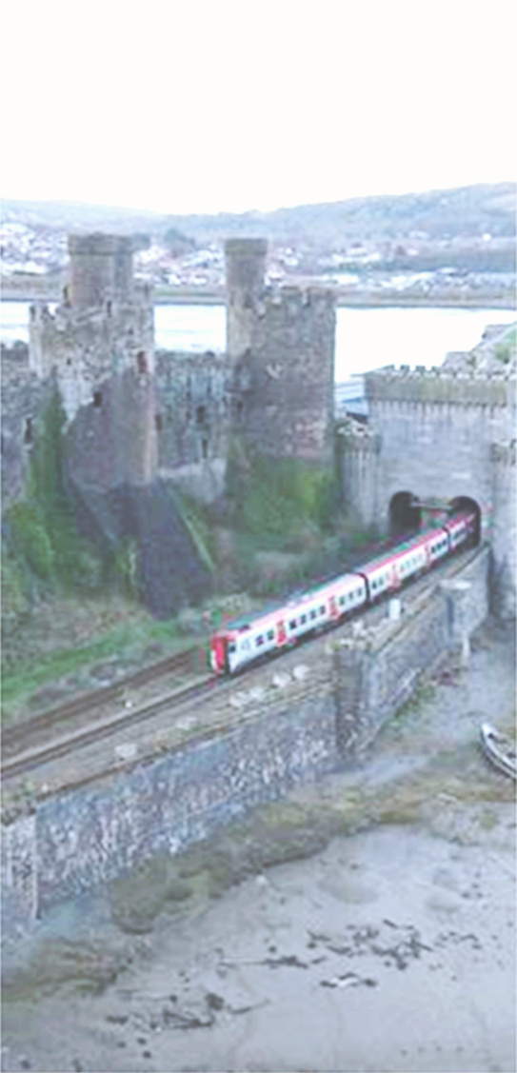
Standard hour Timetable from May’26 for North Wales
Between Llandudno Junction and Holyhead
  1 or 2 TfW trains every hour 08:00 – 19:00 Monday - Saturday between Llandudno Junction and Holyhead
    1tph Manchester Airport service is diverted to Holyhead, calling all stations between Conwy and LlanfairPG then Holyhead
    One train every 2 hours (to/from Cardiff) is fast between Llandudno Junction and Bangor, then calls at all stations between Bangor and Holyhead
    Birmingham trains no longer run beyond Llandudno Junction (except for 1 train each way)
  Stops at Conwy, Llanfairfechan, Penmaenmawr, LlanfairPG and Valley remain/ become compulsory for all trains planned to stop there
  Stops at Bodorgan, Ty Croes and Rhosneigr remain request stops
  All but one TfW train a day calls at LlanfairPG

Slide 17
Standard hour Timetable from May’26 for North Wales
Between Llandudno Junction and Holyhead
  We will offer better timed services for students travelling to schools in Bangor, with a departure from Bangor at 16:10
  We will also now be able to support commuting to Holyhead from stations on Anglesey, with arrivals at Holyhead at 08:14 and departures from Holyhead at 16:25 and 18:25 calling at all Anglesey stations
  Trains from Holyhead at ~17:00 and ~18:00 call at Valley and Llanfairpwll

Slide 18
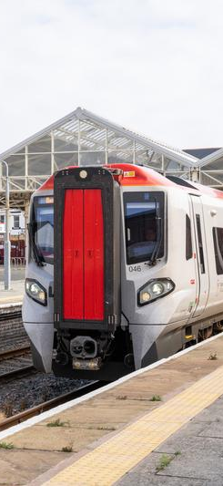
Standard hour Timetable from May’26 for North Wales
Between Llandudno Junction and Llandudno
  2 TfW trains in most hours 07:00 – 19:00 Monday - Saturday between Llandudno and Llandudno Junction
    1tph is to/from Liverpool Lime Street via Runcorn; the other 1tph is either to/from Blaenau Ffestiniog, or a ‘shuttle’ between Llandudno ‘Town’ and Llandudno Junction
    Shuttle trains to/from Llandudno are usually timed to connect into/out of Birmingham/Cardiff and London trains at Llandudno Junction
    Earlier 1st train from Llandudno at 05:35, connecting into 05:54 to Manchester
    Later last train from Llandudno Junction at 21:49, connecting out of 21:45 arrival from Manchester
    There is one through train a day to/from Manchester – at 06:40 from Llandudno and returning from Manchester Airport at 17:25, arriving at Llandudno at 20:03

Slide 19
Standard hour Timetable from May’26 for North Wales
Between Llandudno Junction and Llandudno
  Diverting the Manchester trains to Holyhead means we can better connect Bangor and Holyhead to destinations in Northwest England, and offer better connections with ferries to and from Dublin
  We’ve not taken this decision lightly, and we recognise that timetable changes always involves trade-offs. Our intention is always to maximise the benefits to the greatest number number of passengers
  Some people will experience change they’ll not welcome, but many others will find their travel easier - or even that rail becomes a viable way of travel for them when it wasn’t before

Slide 20
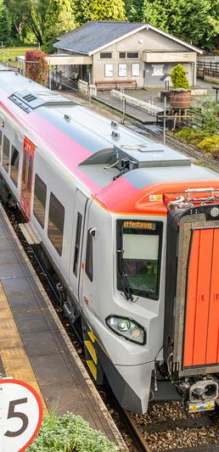
Standard hour Timetable from May’26 for North Wales
Conwy Valley
  The one-train service continues to run every 3 hours at approximately today’s times
  It no longer performs other journeys in the middle of the day and will have longer recovery time after each journey – this should improve reliability
  The first journey in the morning will extend to Llandudno (Town)
  Running times amended to allow for rail-head conditions and infrastructure condition (Ffestiniog Tunnel, from Dec’26)

Slide 21
Any questions?

